Slide 1
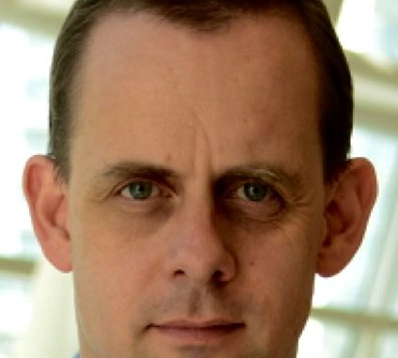
Ask the Experts Office Hours Kofax RPA Open Office #9
David Wright, RPA Partner Development Manager
7 august 2019
David Wright, Partner Development Manager

Slide 2
Previous Open Office Topics
Month | Topics
Jan 2019 | Cognitive Document Automation
Feb 2019 | Powerful Demo Robots, Sentiment Analysis, Getting robots to work on a website.
Mar 2019 | Process Analysis, Finding the right Processes to Automate, Metrics
Apr 2019 | Robot Lifecycle Management
May 2019 | Security, Tomcat
Jun 2019 | POP3, IMAP, MS Exchange, Robot Memory
July 2019 | PDF
Aug 2019 | Robot File System. Desktop Automation Loops

Slide 3
Kofax RPA 10.5 (April 2019)
Cognitive Document Automation
Incremental Learning
Document Separation
Batch Handling (more than one document at a time)
Single Sign-On for Management Console
Kofax Analytics for RPA
Updated UI
New Capabilities
Online Demo
Management Console UI updates
New Functions in Workflow Automation

Slide 4
Kofax RPA 10.6 (June 2019)
New icons
Minor improvements to Desktop Automation, including Help Access
Robot File System (RFS)
Start Kofax Total Agility (KTA) Process
Offline Help

Slide 5
Online Learning

Slide 6



Cognitive Document Automation
Robots can now
understand any kind of document
interact with humans.
Learn from humans

Slide 7





What is Document Understanding? (All information has context)
General Knowledge
Specific Knowledge
Learning
Understanding
=
Reading
+
+
+
Precisely knowing the intent of the author
OCR
Letters & words
This is not understanding
People’s names, City names, Tax rates, Mathematics, Month names, Job names…
Date of birth of each customer, order database signature always on the last page.
Remember and use new general & specific knowledge next time.
Notes:
Reading= OCR = intelligence of a 4 year old child.
General knowledge (about documents and the world)= city names, zips codes, mathematics, languages, spelling, month names, common occupations.
The words “date” and “Datum” often appear to the left of a date.
One Third of Americans share only 1000 family names – Smith, Johnson, Williams, Brown, Jones, Miller, Davis, Garcia, Rodriguez.
Robots are good at getting general knowledge about the world.
Specific knowledge (about this document) = the address and date of birth of every customer. Database of recent orders. This document always has the date in top left corner.
Learning by observing= gaining general and specific knowledge.

Slide 8
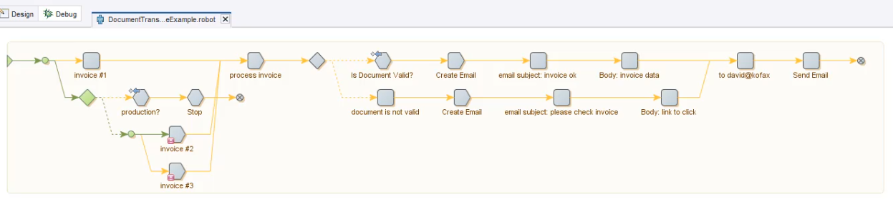
Demo

Slide 9
Open Questions!

Slide 10
Open Questions!

